Slide 1

The Building Code Effectiveness Grading Schedule (BCEGS®)
In collaboration with: Insurers, Community Building Officials, FEMA, ICC, University of Pennsylvania and AIR
California Building Officials
May 18, 2021 – Newport Beach
Presenter: Dale K. Thomure, CBO, CFM
Community Hazard Mitigation Manager - ISO
Notes:
[click for next slide]

Slide 2
About the presentation today……
Who are we? What do we do?
The Building Code Effectiveness Grading Schedule
Use and Application of BCEGS Data – Insurer, Non-Insurer and Federal Government
We will try to answer the following question:
-How are BCEGS classifications utilized by the insurance industry and others?

Slide 3

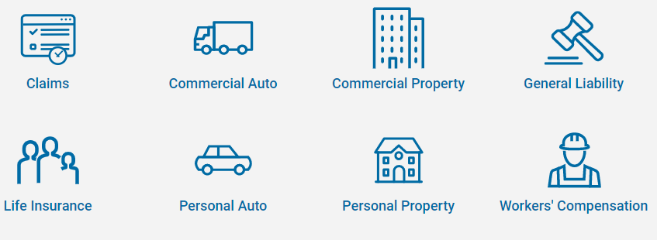

ISO is a Verisk Business
Verisk is licensed rating organization and the leading supplier of:
    Statistical data
    Actuarial data
    Underwriting information
    Standardized coverage forms
    Class & rating programs
    Advisory services

Slide 4
Overview of ISO
Why does ISO exist?
ISO is a result of consolidation of state rating bureaus – 1970.
  Increase efficiency for insurers
  Reduce development costs for insurance products
  Leverage economies of scale
  Benefit from historical aggregate database
  Enhance competition in the insurance marketplace
    Reduce barriers to entry
      new markets
      new lines of business
      new classes of risk
  Provide benchmarks for comparison

Slide 5
Overview of ISO – Industry Need
Unique nature of insurance pricing
  Insurance industry vs. other industries
    True cost of product not known at time product is sold
    Claims may not be submitted for months, years, decades after the policy term has expired
    Need to project future costs based on past data and actuarial projections

Slide 6
Overview of ISO
Advisory
Information
Loss Costs
Rules
Forms
Advisory rating information based on line, class, or occupancy (created from data analysis)
Classification and rating rules (the commercial
and personal lines manuals)
Policy forms (language)
for all lines of business under ISO jurisdiction

Slide 7



ISO – Community Mitigation Programs
Fire Suppression Rating Schedule (FSRS)
Public Protection Classification (PPC ®) Program
Building Code Effectiveness Grading Schedule (BCEGS®)
*FEMA/NFIP Community Rating System (CRS)
* Administrator of program

Slide 8
Building Code Effectiveness Grading Schedule (BCEGS®)
Unique Industry Program
100 Point Grading System in DOI Filed Schedule
Considers over 1200 elements
Three main categories:
  Administration of Codes (54%)
  Review of Building Plans (23%)
  Field Inspections (23%)
Aggregated into classifications
of 1–10 for both Personal and Commercial Lines
  Class 99
4 to 5-year data refresh
Historic data specific to each evaluation year utilized based on construction year of risks
BCEGS is designed to measures resources and support made available to the enforcement of building codes and the utilization of those resources at the community level.
VS.

Slide 9
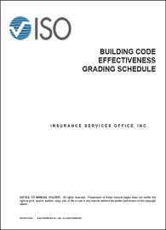
Evaluation of Community-Level Enforcement
BCEGS Areas of Focus
Code Administration | Adopted Building Code Adopted Sub-Codes State and Local Code Amendments Method of Code Adoption Natural Hazards Impacting the Jurisdiction Staff Training and Education Certification of Staff Qualification of the Building Official Utilization of Design Professionals Zoning and Land-Use Provisions Contractor Licensing Programs Public Awareness Programs Appeals Process Administrative Policies and Procedures Quality Assurance Programs
Plan Review | Plan Review Staffing Experience of Plan Review Personnel Detail of Plan Review Management of Plan Review Activity
Field Inspection | Inspection Staffing Experience of Inspection Personnel Management of Inspection Activity Inspection Checklists Special Inspections Inspections for Natural Hazard Mitigation Final Inspections Certificates of Occupancy
54%
PL and CL Classification
Database Storage of Granular Data Elements for Underwriting Usage
23%
23%

Slide 10






BCEGS is an Indicator of Community Vulnerability
Consider the two towns below:
Modern Building Code
Weakened or No Building Code
Effective Code Enforcement
Poor or No Code Enforcement
Class 1
Class 10 or 99
Low
High
Vulnerability

Slide 11
BCEGS Benchmarking - National Classifications

Slide 12
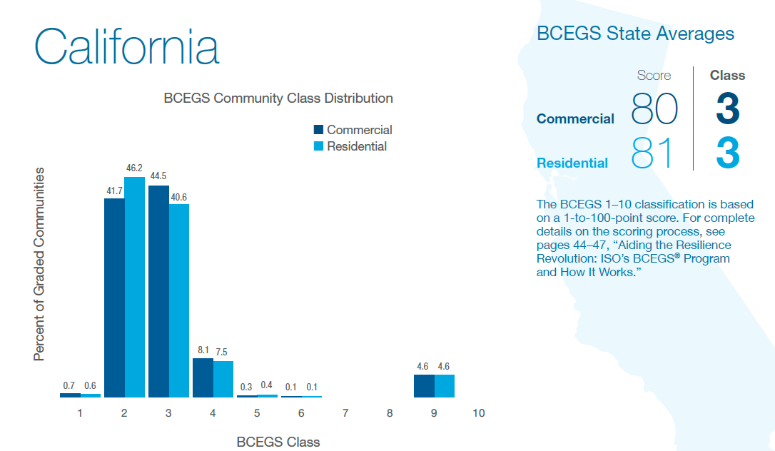
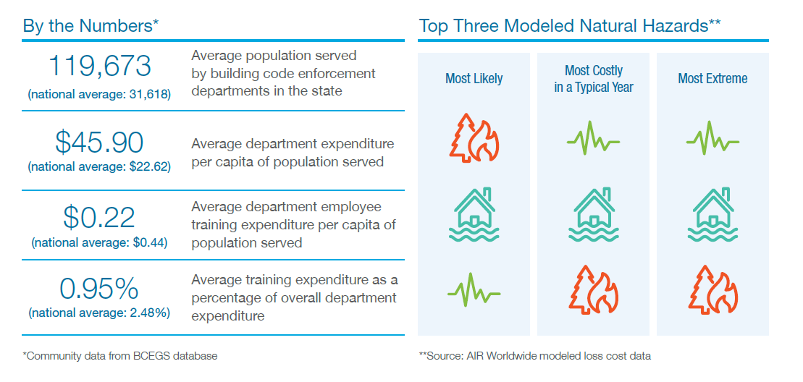

Slide 13
BCEGS Data Usage and Applicability
Filed Advisory Credits
Building Underwriting Reports
Enhanced Wind Rating
AIR Cat Models
BCEGS
Insurance Rating & Underwriting
FEMA Grant Programs
Academic Studies
NFIP CRS Program
Code Advocacy
Resiliency and Mitigation Efforts
BCEGS is a Key Element in CRS
Tied Directly to Flood Insurance Discounts
Local Government Management Tools - Benchmarking
ICC Code Development
Hazard Mitigation Grant Programs
Loss Avoidance Study
Code Adoption Tracking
Wharton Risk Center Studies of BCEGS
FLASH
“No Code, No Confidence”
Code Advocacy

Slide 14
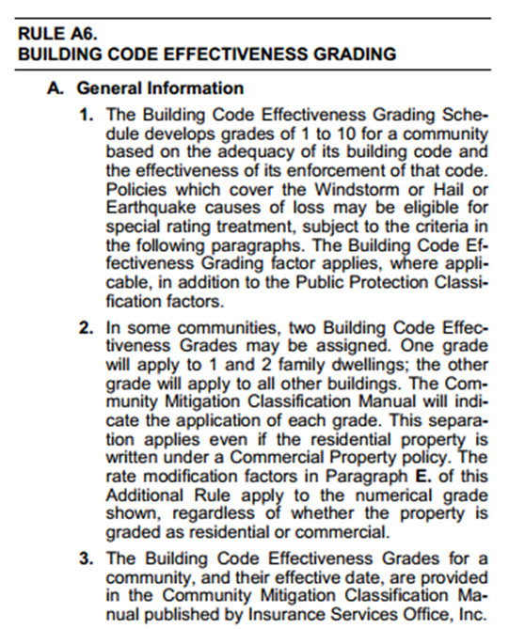
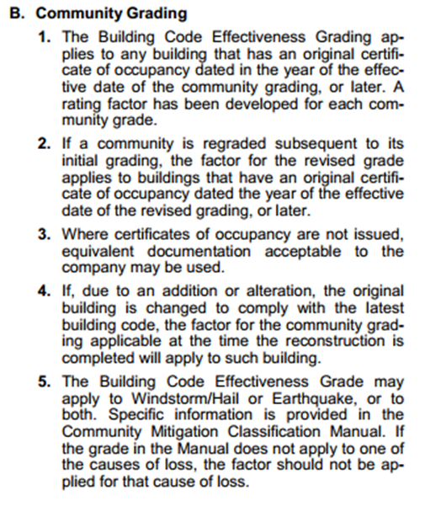
BCEGS Filed Advisory Rating
What’s a filing?
  The process of obtaining required regulatory acceptance of ISO’s core products (loss costs, rules and forms) for use by participating insurers.

Slide 15

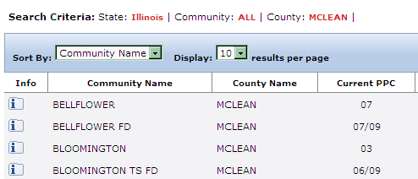

ISO Delivery of BCEGS to Insurance Carriers
Assignment of BCEGS to community level based on year of construction
BCEGS 1-10 Classifications
LOCATION®
CMC Manual
Subscription (included within Participation) to utilize BCEGS.
^{PROMETRIX®}
BCEGS Data
Granular data provided in Building Underwriting Reports
Loss-Cost Factors are provided for BCEGS

Slide 16
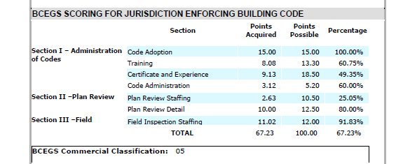
BCEGS Data Application – Building UW
Building Underwriting Reports (BUR)

Slide 17
BCEGS in BG II Loss Cost
BCEGS Data Application – Advisory Loss Cost
Advisory Loss Cost is a projection of an insurer’s average future loss and loss adjustment expenses
Delivered for both BG I (fire) and BG II (wind)
Based on Construction, Occupancy, Protection and Exposure (COPE) information published by Verisk
Developed using field-verified property information as well as historical premium and claims data
BCEGS factor can be used by insurers to adjust the BG II loss Cost
Utilizes ISO’s 3 rating schedules – SCOPES, FSRS and BCEGS
Loss Cost + Expense Load + Profit Load = Rate
Notes:
The Loss Cost is our most comprehensive analytic
The Loss Cost is a projection of an insurer’s average future loss and loss adjustment expenses
Delivered for both BG I (primarily fire) and BG II (primarily wind)
It is based on field-verified property information, as well as historical premium and claims data
Utilizes our 3 rating schedules – Primarily SCOPES, FSRS and BCEGS
SCOPES (Specific Commercial Property Evaluation Schedule) - the detailed assessment of the building-specific fire risk from an engineering viewpoint.
ELA (Experience Level Adjustment) - the detailed review of insurance industry premium/loss experience.
FSRS (Fire Suppression Rating Schedule) - the detailed assessment of the fire protection (suppression) capabilities of various communities
BCEGS (Building Code Effectiveness Grading Schedule) - the detailed assessment of building code adoption and enforcement at the time of construction
Loss Cost + Expense Load + Profit Load = Rate
The slide shows a partial copy of the Loss Cost report. The Loss Cost report gives key rating characteristics of a building
RCP
RCB
Territory codes
BG I Loss Cost
BG II Loss Cost
An accurate loss cost is essential for determining appropriate pricing

Slide 18
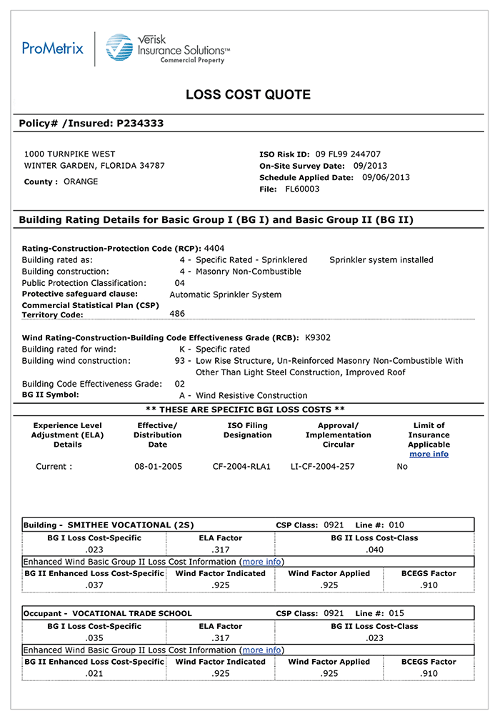
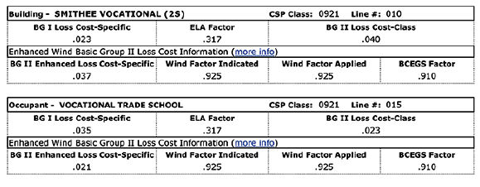
BCEGS in BG II Loss Cost
BCEGS Data Application – Advisory Loss Cost
Notes:
The Loss Cost is our most comprehensive analytic
The Loss Cost is a projection of an insurer’s average future loss and loss adjustment expenses
Delivered for both BG I (primarily fire) and BG II (primarily wind)
It is based on field-verified property information, as well as historical premium and claims data
Utilizes our 3 rating schedules – Primarily SCOPES, FSRS and BCEGS
SCOPES (Specific Commercial Property Evaluation Schedule) - the detailed assessment of the building-specific fire risk from an engineering viewpoint.
ELA (Experience Level Adjustment) - the detailed review of insurance industry premium/loss experience.
FSRS (Fire Suppression Rating Schedule) - the detailed assessment of the fire protection (suppression) capabilities of various communities
BCEGS (Building Code Effectiveness Grading Schedule) - the detailed assessment of building code adoption and enforcement at the time of construction
Loss Cost + Expense Load + Profit Load = Rate
The slide shows a partial copy of the Loss Cost report. The Loss Cost report gives key rating characteristics of a building
RCP
RCB
Territory codes
BG I Loss Cost
BG II Loss Cost
An accurate loss cost is essential for determining appropriate pricing

Slide 19
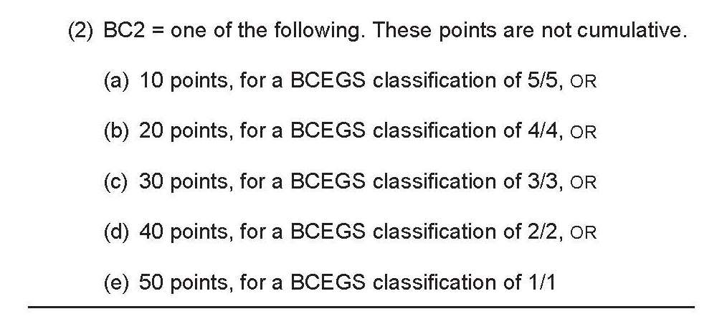
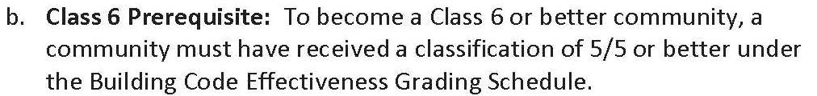
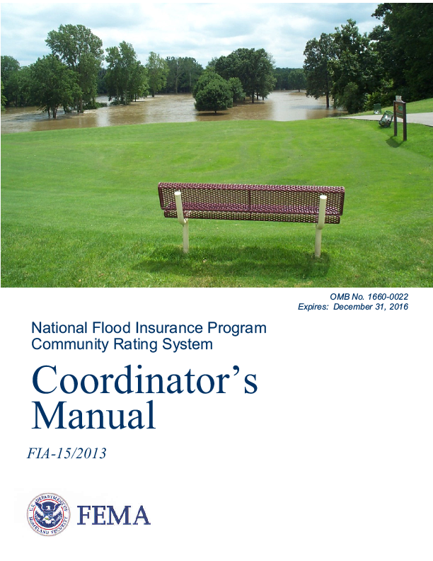
BCEGS Data Application – CRS Program
Community Rating System (CRS)
432.h BC2 credits the community’s Building Code Effectiveness Grading Schedule (BCEGS) classification.

Slide 20
BCEGS Data Application – CRS Program

Slide 21
CRS Program Flood Insurance Discounts
$ 9.3 M*
Total Yearly Premium Savings for Policy Holders in the ___CRS Communities across ___
*Source: FEMA, NFIP Insurance Savings Report

Slide 22
AIR Hazard Modeling
BCEGS Classifications and Data are utilized in the AIR risk models.

Slide 23


In AIR Loss-Cost Modeling –
BCEGS is an Indicator of Building Vulnerability
Consider the two homes below:
Features of a Building Built to Code
Features of a Building Not Built to Code
Elements of Good Code Enforcement
Poor or No Code Enforcement
Class 1
Class 10 or 99
Low
High
Vulnerability

Slide 24
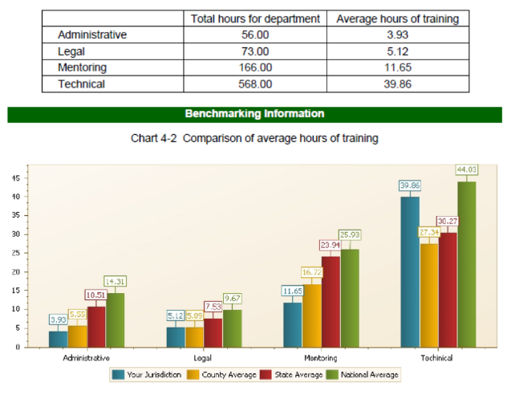
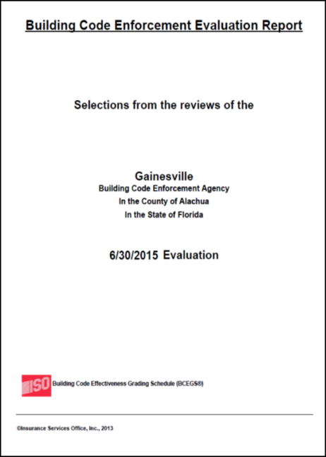
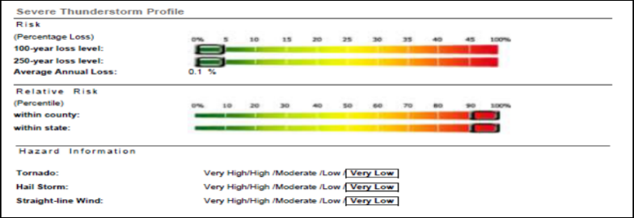
ISO Community Benchmark Reports
Hyper-Local Analysis of Enforcement Efforts
ISO provides every community with a detailed Benchmark Report. Benchmark Reports are local-facing and include peer comparisons to be utilized for department management efforts. This information is provided free of charge.

Slide 25


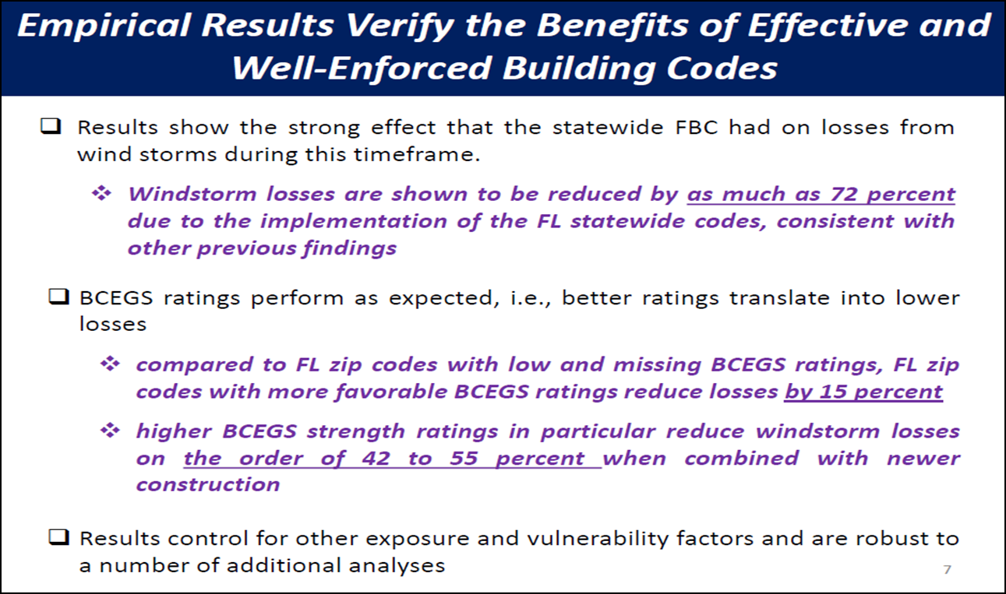
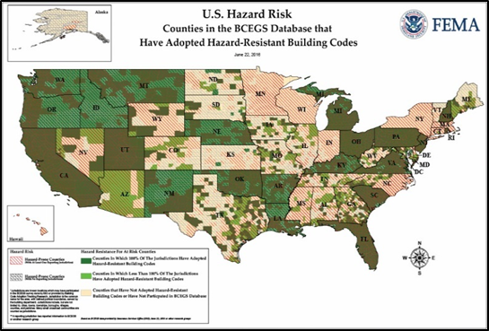

Building Code Reports and Studies that Support Building Codes and Code Enforcement Efforts
Risk Management and Decision Processes Center - PENN
FEMA Building Sciences Branch / Federal Insurance and Mitigation Administration

Slide 26
BCEGS Relationship to FEMA Grants
FEMA Hazard Mitigation Grant Program – Post Disaster
Part of Hazard Mitigation Assistance (HMA)
Additional 5% Initiative
  5% may be used to fund additional hazard mitigation measures
  May increase up to 10% for additional activities that promote disaster-resistant codes
  Must adopt disaster-resistant codes or improve or establish a BCEGS score.
Notes:
Part of Hazard Mitigation Assistance
Program provides funding for mitigation measures when authorized under a presidential major disaster declaration in areas of the state requested by the governor.
Program has provisions for amount of funds used for approved activities
Opportunity to use additional percentage of funds on hazard mitigation measures that would not normally be under ‘approved’ or measurable (e.g. citizen warning systems, hazard mapping, acquiring GIS software, public awareness programs RE: mitigation, NEW COD EVALUATION): In order to qualify, recipients must adopt disaster-resistant building codes OR improve their BCEGS rating.
Can increase to 10% of funds to use for activities that address promoting disaster-resistant codes (e.g. adoption and enforcement of latest IBC/IRC, improving BCEGS score, upgrading existing code with disaster-resistant provisions, integrating flood-resistant code elements into local floodplain ordinances)
Community MUST AGREE to adopt disaster-resistant codes OR improve BCEGS rating. Funds can be applied to working towards either or both.

Slide 27
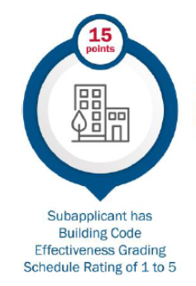
BCEGS Relationship to FEMA Grants
FEMA BRIC Program – Pre-Disaster
BRIC Grants are awarded based on a scoring system
BCEGS Class of 1 to 5 is eligible for review points
BCEGS Class for BRIC credit is based on the subapplicant
If a State: Use the state average found in the 2019 National Building Code Assessment Report.
  2021 Grant Cycle will utilize ISO published State Averages – Under Development Now
If a Local Unit of Government; use the BCEGS Class assigned to that unit of government.
If a Quasi-Governmental Entity or Other (water district, drainage district, as examples); use the BCEGS classification applicable to the physical location of the project.

Slide 28
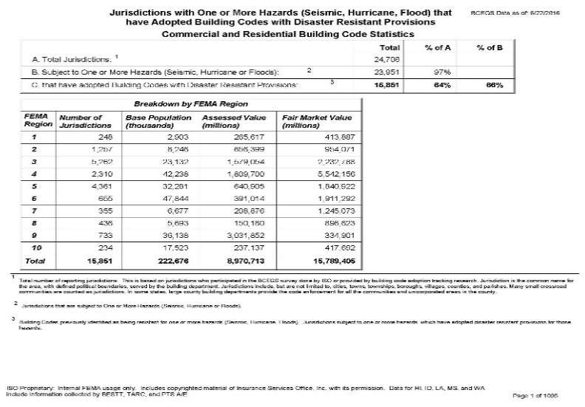
FEMA Building Code Monitoring and
Tracking Efforts that Assist in Federal Policy Making
Building Codes = Better Built Buildings, Better Performance
FEMA relies on ISO BCEGS to bolster their national knowledge related to codes and enforcement efforts – leveraging the ISO field expertise.
Communities that do not cooperate with BCEGS surveys do not have their efforts fully recognized in FEMA Tracking.
Slide Courtesy of FEMA Building Sciences Branch – John Ingargiola

Slide 29
ISO National Building Code Assessment Report - 2019
“ A basis for first conversations with local decision-makers.”
Second report on the State of Building Codes in the Nation
Focused on the Human Element of Building Code Enforcement
Insights powered by BCEGS Data and ISO Internal Expertise
Insurer and Code Industry Facing Content
Designed to provide actionable information to advance the cause of Community Resilience through Good Public Policy
Partner and Subsidiary Content
  FLASH
  ICC
  FEMA – Building Sciences Branch
  AIR Worldwide, A Verisk Business
  Wharton Risk Decision Processes Center, Austin College, National Center for Atmospheric Research (NCAR)
  ISO Risk Engineering Group
  Property Claim Service – PCS, A Verisk Business

Slide 30
All materials and studies referenced today are available upon request. For more information, please contact the persons listed below:
dthomure@iso.com
bhutchings@iso.com
Or visit: isomitigation.com

